Slide 1
Executive Summary
Executive Summary

Slide 2
Platform: AWS
Account Number: 354
Category: Security, Reliability, Performance Efficiency
Framework: NIST Cybersecurity Framework v1.1
Risk Levels: Extreme, Very_High, High
Relability
77% Compliant
It could be better
Filter Checked: 879858
Succeeded: 648526
Failed: 231332
Filter Checked: 879858
Succeeded: 648526
Failed: 231332
Filter Checked: 879858
Succeeded: 648526
Failed: 231332
AWS için kural isimleri olacak

Slide 3
Platform: GCP
Account Number:154
Category:Security, Reliability, Performance Efficiency
Framework: NIST Cybersecurity Framework v1.1
Risk Levels: Extreme, Very_High, High
Filter Checked: 879858
Succeeded: 648526
Failed: 231332
Filter Checked: 879858
Succeeded: 648526
Failed: 231332
Filter Checked: 879858
Succeeded: 648526
Failed: 231332
GCP için kural isimleri olacak

Slide 4
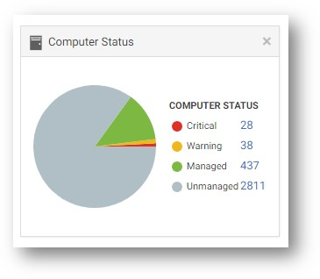
Workload Security
Excel’ den veri çekilerek gidilebilir, karar senin.
Kural isimleri

